Slide 1
JNCIS-ENT
Border Gateway Protocol (BGP)

Slide 2
BGP Message Types
2
The 4 messages for the protocol of the internet

Slide 3
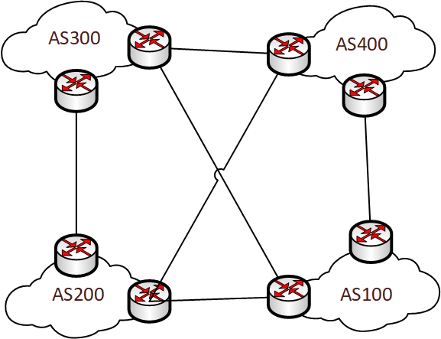
4 Message Types
BGP has 4 message types used throughout the peering lifecycle
Open
Update
Keepalive
Notification
An Update message can double as a Keepalive and will reset the dead timer for the peer when received

Slide 4

BGP Message Header
The header is included on all BGP message types
The marker is set to all 1’s

Slide 5
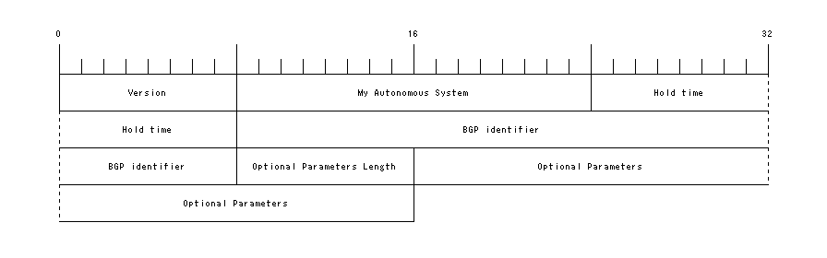
BGP Open Message
The Open message only advertises:
Local router’s autonomous system number
Local Router ID
multiprotocol BGP extensions it’s capable of exchanging.

Slide 6
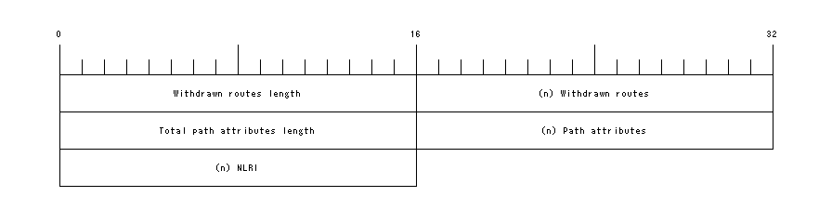
BGP Update Message
The Update message is used to advertise or withdraw route advertisements
The withdrawn routes, path attributes and NLRI fields are variable length and can be missing from the message if none are being advertised/wathdrawn

Slide 7
BGP Keepalive Message
The keepalive is used to maintain knowledge of reliable communication between peers.
Contains only the BGP header and no additional fields

Slide 8

BGP Notification Message
Used to teardown a BGP peering
Can be sent when an error is encountered or when a peering is administratively removed or disabled
The data field is variable length and may or may not hold useful information regarding the teardown

